Slide 1

Data Structures
Lecture 16: Hash Tables

Slide 2

Hash Tables
The C++ library uses balanced search trees to implement sets and maps.
This gives access to items in O ( log n).
Sets and maps can be implemented using a data structure known as a hash table (In C++, this is called unordered_map).
The idea behind hash tables is to access items directly through their key values.
With hash tables, accessing an item on average is O(1).

Slide 3
Hash Codes and Index Calculation
Hashing: transforming the item’s key value into an integer value (hash code), which will be transformed into a table index.
Example: To build a Huffman tree, you need to know the number of occurrences of each character in the text being considered.
int index = ascii_char;
Index | Value
65 | 64
66 | 13
.. | …
ASCII value for “A”
A’s frequency
ASCII value for “B”
B’s frequency

Slide 4
Hash Codes for Unicode Characters (1)
There are 2¹⁶ (65,536) Unicode characters. However, for a given file, let’s assume that at most 100 different characters actually appear.
Rather than use a table with 65,536 elements, it would be more sensible to store the items in a smaller table (say 200 elements)
We can calculate the array index for character uni_char (type wchar_t) as:
int index = uni_char % 200;
What is the problem with this approach?

Slide 5
Hash Codes for Unicode Characters (2)
Character | Unicode value | Hash Code
Í | 205 | 5
م | 1605 | 5
This situation is known as collision.

Slide 6
Functions for Generating Hash Codes (1)
In most applications, keys consist of strings of letters or digits rather than a single character (e.g. social security number).
Simple algorithms generate a lot of collisions.
For instance, generating a hash code based on summing the ascii value of all characters in a string will generate the same index for words that contain the same letters such as “sign” and “sing”

Slide 7
Functions for Generating Hash Codes (2)
One algorithm that has shown good results uses the following formula:
n-3
This formula is used by a hash function in the Java String class.

Slide 8
Qualities of the String Hash Function
The probability for two strings have the same hash code is relatively small.
Each letter affects the value.
The order of each letter affects the value.
  The values tend to be spread well over the integers (That is, every hash value in the output range should be generated with roughly the same probability.)
Good Qualities of a Hash Function
  Spread values evenly.
  Cheap to compute.

Slide 9
Ways to Resolve Collision
Open addressing - linear probing
Chaining.

Slide 10
Open Addressing - Linear Probing
Finding an item with a specific hash key.
Search Termination
1. Compute index as hash_fcn() % table.size()
2. if table[index] == NULL
3. item is not in the table.
4. else if table[index] matches item
5. The item is in the table.
else
Continue to search the table by incrementing the index until either the item is found or a NULL entry is found.
Ways to obtain proper termination
  Stop when you come back to your starting point
  Stop after probing N slots, where N is table size
  Ensure table never full
    Reallocate when occupancy exceeds threshold

Slide 11
Open Addressing (Linear Probing) – Example
Key | hash_fcn() | hash_fcn()%5 | hash_fcn()%11
“Tom” | 84274 | 4 | 3
“John” | 2129869 | 4 | 5
“Harry” | 69496448 | 3 | 10
“Sam” | 82879 | 4 | 5
“Pete” | 2484038 | 3 | 7
0 | NULL
1 | NULL
2 | NULL
3 | NULL
4 | NULL
  1
“John”
0 | NULL
1 | NULL
2 | NULL
3 | NULL
4 | NULL
5 | NULL
6 | NULL
7 | NULL
8 | NULL
9 | NULL
10 | NULL
“Sam”
  2
“Pete”
  4
  0
  0
“Harry”
“Tom”
“Tom”
  0
  0
“John”
“Sam”
  1
  0
“Pete”
Increasing the table size reduces the probability of a collision
  0
“Harry”

Slide 12
Traversing a Hash Table
You can’t traverse a hash table in a meaningful way.
0 | NULL
1 | NULL
2 | NULL
3 | NULL
4 | NULL
0 | NULL
1 | NULL
2 | NULL
3 | NULL
4 | NULL
5 | NULL
6 | NULL
7 | NULL
8 | NULL
9 | NULL
10 | NULL
“John”
“Sam”
“Pete”
“Harry”
“Tom”
“Tom”
“John”
“John”, “Sam”, “Pete”, “Harry”, “Tom”
“Sam”
“Pete”
“Harry”
“Tom”, “John”, “Sam”, “Pete”, “Harry”

Slide 13
Deleting an Item Using Open Addressing
We can’t delete an item by setting it to NULL.
Item Index | Table index | Key
4 | 0 | “John”
 | 1 | NULL
 | 2 | NULL
 | 3 | NULL
4 | 4 | “Tom”
Instead, we mark it as deleted (by storing a dummy value)
DELETED
This might lead to search inefficiency particularly if there are many deletions.
NULL
John is not accessible anymore.
If the table is almost full and most of the items are deleted, you will have O(n) performance when searching for the few items remaining in the table.

Slide 14
Reducing Collisions by Expanding the Table Size
Use a prime number for the size of the table.
Item Index | Table index | Key
4 | 0 | “John”
4 | 1 | “Sam”
3 | 2 | “Pete”
3 | 3 | “Harry”
4 | 4 | “Tom”
 | 5 | NULL
 | 6 | NULL
 | 7 | NULL
 | 8 | NULL
 | 9 | NULL
 | 10 | NULL
Item Index | Table index | Key
4 | 0 | “John”
4 | 1 | “Sam”
3 | 2 | “Pete”
3 | 3 | “Harry”
4 | 4 | “Tom”
The probability of a collision is proportional to how full the table is. Hence, when the hash table becomes sufficiently full, a larger table should be allocated and the entries reinserted.
Simply copying the values in the original array to the new array doesn’t work
Rehashing means inserting the items all over again one by one.

Slide 15
The Problem with Linear Probing
Linear probing forms clusters of keys in the table causing longer search chains.
Inserting (5,6,5,6,7)
Linear Probing
Index | Value
0
1
2
3
4
5
6
7
8
9
10
5 | 1st item with code 5
0
6 | 1st item with code 6
0
7 | 2nd item with code 5
2
8 | 2nd item with code 6
2
9 | 1st item with code 7
2

Slide 16
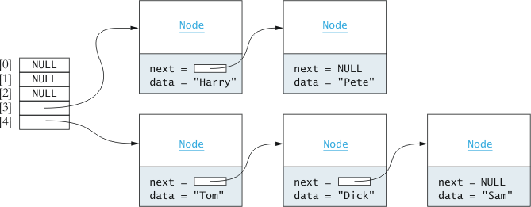
Chaining
Each table element references a linked list that contains all the items that hash to the same index.
To resolve collisions, you traverse the referenced linked list.
Advantages
Only items with the same hashed index will be examined.
You can store more elements in the table than the table size.
To delete an item, simply remove it from the list.

Slide 17
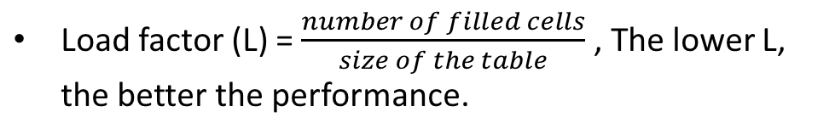
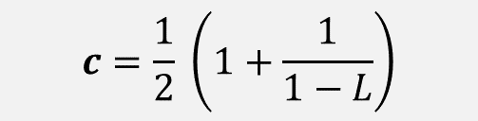

Performance of Hash Tables
L | Probes with Linear Probing | Probes with Chaining
0 | 1.00 | 1.00
0.25 | 1.17 | 1.13
0.5 | 1.50 | 1.25
0.75 | 2.50 | 1.38
0.85 | 3.83 | 1.43
0.9 | 5.50 | 1.45
0.95 | 10.50 | 1.48
0<= L <1 (for linear probing tables)
Expected number of comparisons, c, for finding an item in a hash table using open addressing with linear probing.
With chaining:

Slide 18

Task
The following table stores int keys and needs to be rehashed using open addressing (linear probing) and chaining.
Show what the new tables would look like as a result of rehashing this table.
Index | Hash Key
0 | 24
1 | 6
2 | 20
3
4 | 14

Slide 19
Solution
Open addressing
Chaining
Old table
Index | Hash Key
0 | NULL
1 | NULL
2 | NULL
3 | NULL
4 | NULL
5 | NULL
6 | NULL
7 | NULL
8 | NULL
9 | NULL
Index | Hash Key
0 | NULL
1 | NULL
2 | NULL
3 | NULL
4 | NULL
5 | NULL
6 | NULL
7 | NULL
8 | NULL
9 | NULL
Index | Hash Key
0 | 24
1 | 6
2 | 20
3 | NULL
4 | 14
0 | 20
0 | 20
4 | 24, 14
4 | 24
4 | 24
5 | 14
6 | 6
6 | 6

Slide 20

Task
Compare the storage requirements (size) for a hash table with open addressing, a table size of 500, and a load factor of 0.5, with a hash table that uses chaining and gives the same performance.
Open addressing, linear probing
c = ½(1+1/0.5)= 1.5
L = filled cells/size
0.5=filled cells/500. filled cells = 250
Chaining
1.5 = 1 + L/2, L = 1
L = filled cells/size
1=250/size, size = 250, but with one pointer per node, the overhead is the same

Slide 21
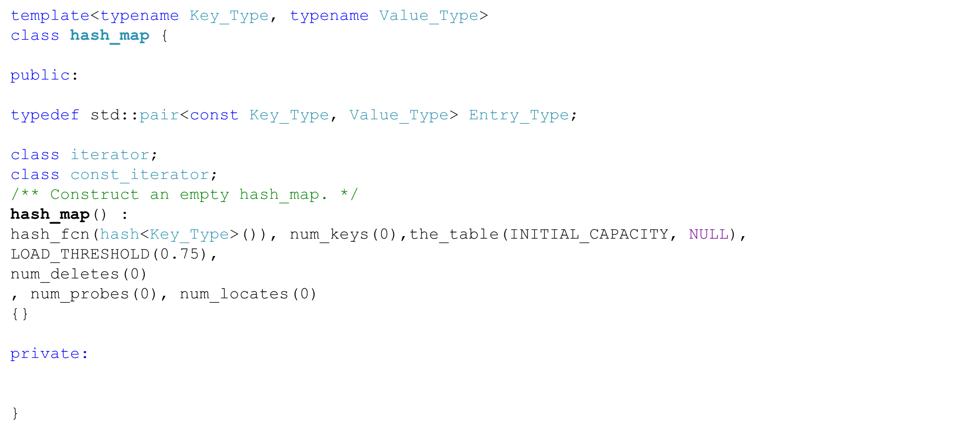
Implementing Hash Tables (Using Open Addressing and Linear Probing)

Slide 22






Hash Table Data Fields
Data Field | Attribute
 | The function object that will compute the hash function for the Key_Type
 | The number of keys in the table, excluding the deleted keys.
 | The hash table vector
 | The initial capacity.
 | The maximum load factor
 | Uses to mark deleted entries.

Slide 23






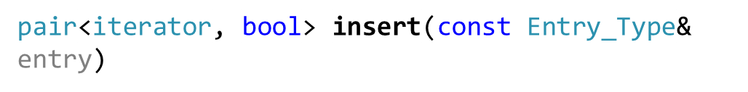
Hash Table Functions (1)
Function | Behavior
 | Returns an iterator to the first entry in the table.
 | Returns an iterator to one past the last entry in the table.
 | Returns true if there are no entries in the table.
 | Returns the number of entries in the table.
 | Inserts an entry into the table. If the key is not in the table, the returned iterator will reference the inserted entry, and the bool result will be true. If the key is already in the table, the returned iterator will reference the entry that is currently in the map with this key, and the bool result will be false.

Slide 24


Hash Table Functions (2)
Function | Behavior
 | Removes the item from the table.
 | Returns an iterator that references the item in the table. If the item is not present, end() is returned.
 | Returns a reference to the value associated with the key. If the key is not associated with a value, inserts a default value into the table and returns a reference to the inserted object.

Slide 25
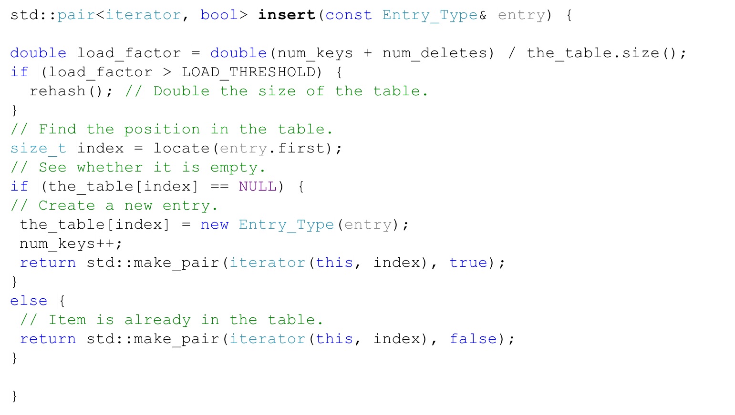
The insert method
Inserting key “9” with hash index 4
i | Value | hash index
0 | NULL
1 | NULL
2 | NULL
3 | NULL
4 | <“4”,”Tom”> | 4

Slide 26
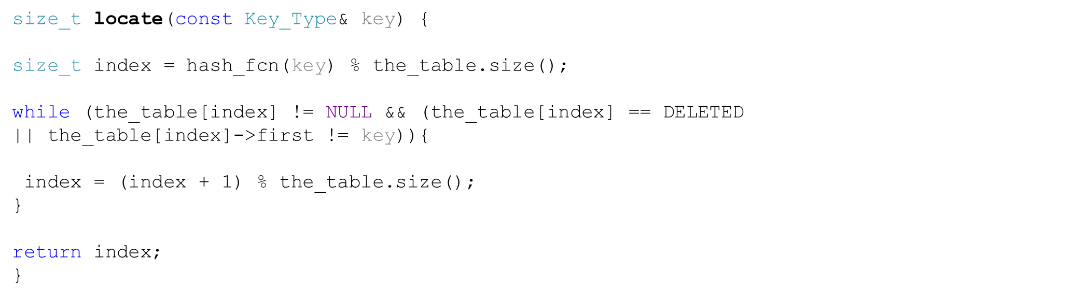
The locate method
Inserting key “9” with hash index 4
i | Value | hash index
0 | NULL
1 | NULL
2 | NULL
3 | NULL
4 | <“4”,”Tom”> | 4

Slide 27
The insert method
Inserting key “9” with hash index 4
i | Value | hash index
0 | NULL
1 | NULL
2 | NULL
3 | NULL
4 | <“4”,”Tom”> | 4
0 | <“9”,”John”> | 4

Slide 28
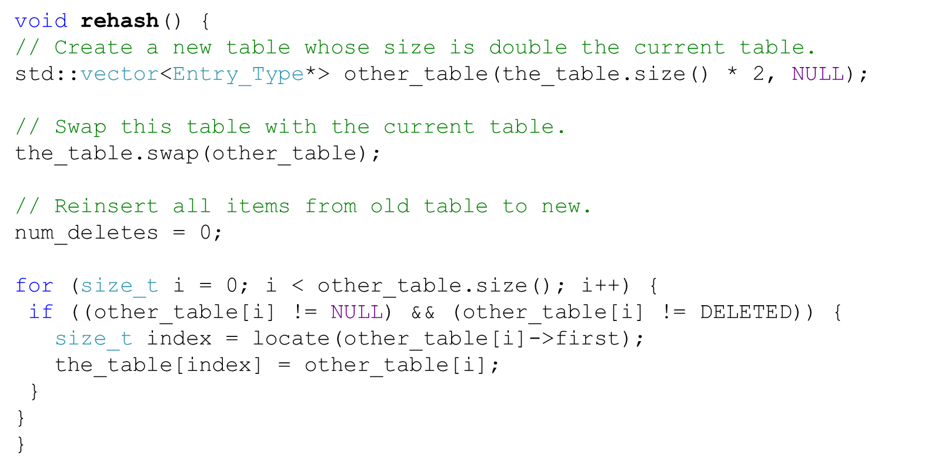
The rehash method

Slide 29
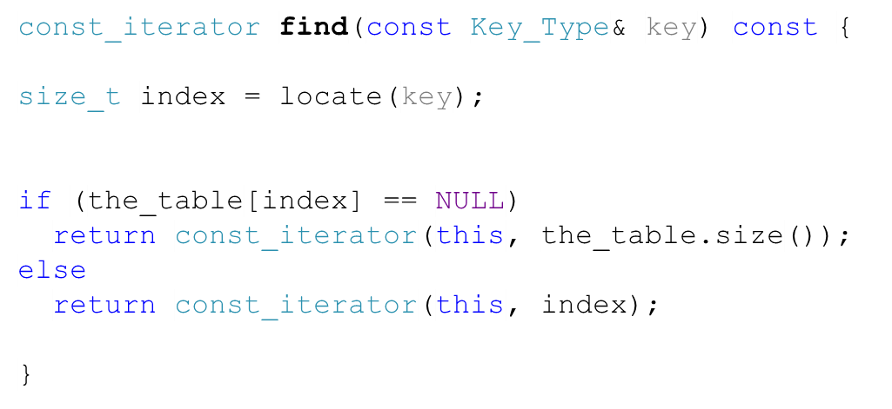
The find method

Slide 30
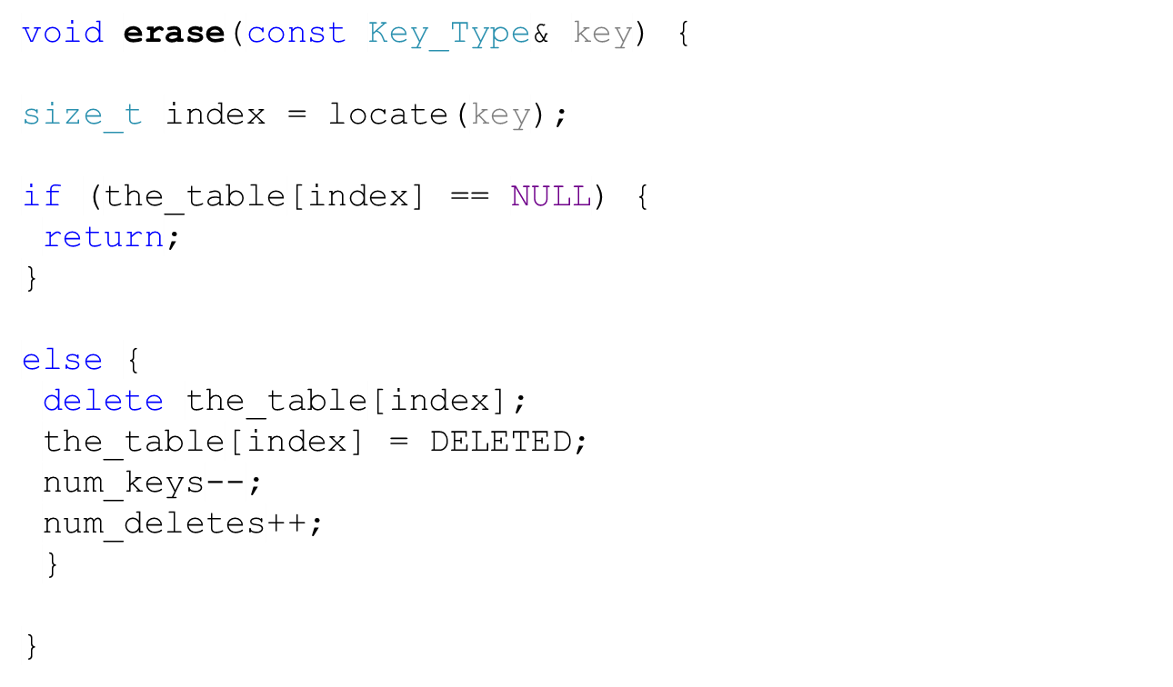
The erase method

Slide 31
Hash Tables vs. Sorted Arrays and Binary Search Trees
 | Hash Tables | Sorted Arrays | Binary Search Trees (Unbalanced)
Insertion (on average) | O(1) | O( n) | O ( log n)
Search (on average) | O(1) | O (log n) | O (log n)
Insertion (worst) | O(n) | O( n) | O(n)
Search (worst) | O(n) | O (log n) | O(n)
Overall Performance | Performance is better than BST if L < 0.75
Does that mean BSTs are useless?

Slide 32
Usage of Hash Tables and Binary Search Trees
Data Structure | Usage
BST | Quick search, insertion, deletion (log n). Also good when you want queries (items that start with, greater than, less than, range, etc.) Good when you want to retrieve a sorted list of items.
Hash tables (Hash maps) | Fast access if key is known. Fast insertion O(1) on average. Allow you to link objects by means of ids rather than references. Otherwise, search is not fast. O (n)

